Slide 1

Project presentation for end semester evaluation
On
Deign and Fabrication of Hydraulic Compression Moulding Machine
Presented by (M35 Group)
Abhishek Mishra(20213075)
Supervised by
Dr. Binayak Nahak
Department of Mechanical Engineering
Motilal Nehru National Institute of Technology Allahabad

Slide 2
CONTENTS
Introduction to Compression Moulding
Materials Used
Working Principle of Compression Moulding
Design of Mould and Die
Machine Setup: Hydraulic Press
Process Parameters (Temperature, Pressure, Time)
Safety Measures and Precautions
Fabrication Steps
Challenges and Troubleshooting

Slide 3
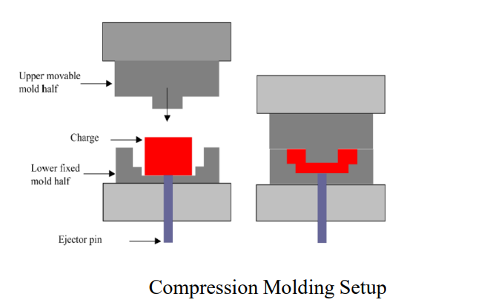
WHAT IS COMPRESSION MOULDING?
Compression molding process is one of the low cost molding methods as compared to injection molding and transfer molding.
It is a high pressure forming process in which the molten plastic material is squeezed directly into a mould cavity, by the application of heat and pressure to conform to the shape of the mold.

Slide 4
CONTI…
In compression molding of thermoplastics , they must be cooled to harden.
So before a molded part is ejected, the entire mold must be cooled, and as a result, the process of compression molding is quite slow with thermoplastics.

Slide 5

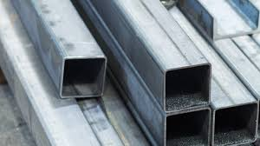
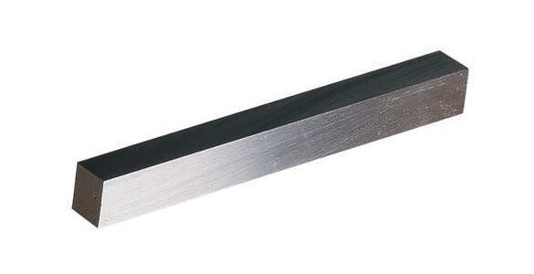
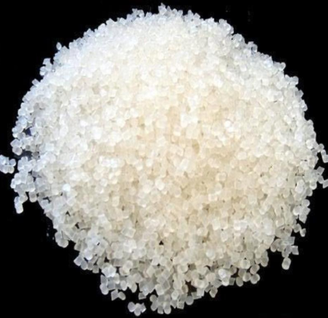
MATERIALS USED
Carbon Steel : Used to fabricate Base and Frame
Mild Steel : Used to fabricate Punch and Die
Polyethylene (LDPE/HDPE) Pellets: Used to fabricate Charge Material

Slide 6
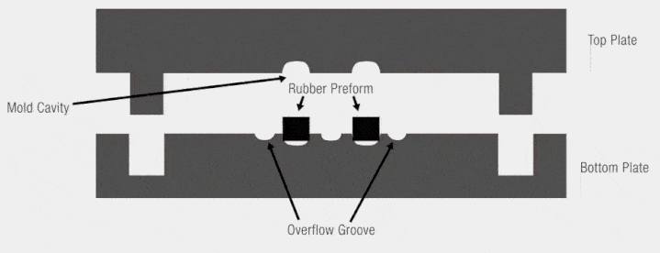
WORKING PRINCIPLE OF MACHINE
Material Preparation A pre-defined amount of raw material, in the form of pellets, sheets, or preforms, is placed directly into the open, heated mould cavity.
Mould Closing The top half of the mould is closed by the press. Hydraulic or mechanical force is applied to compress the material within the mould.
Heating and Forming Heat is applied (usually between 250°F and 400°F), causing the material to flow and fill the mould cavity. The material begins to solidify or set when subjected to continuous pressure.
Cooling and Ejection Once the material is fully cured, the mould is opened and the finished part is removed.

Slide 7
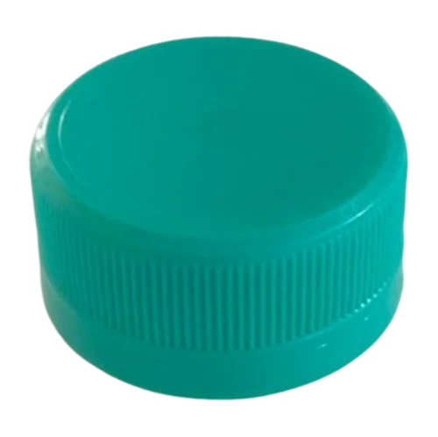
DESIGN OF MOULD AND PUNCH
^{DESIRED PRODUCT :}
^{A BOTTLE CAP}
^{HEIGHT = 1 cm}
^{DIAMETER = 3 cm}
^{THICKNESS = 1 mm = clearance}
PUNCH AND MOULD :
PUNCH :
DIAMETER = 3 cm
HEIGHT = 1 - clearance = 0.9 cm
MOULD :
DIAMETER = 3 + clearance = 3.1 cm
HEIGHT = 1 cm
1 cm
3 cm

Slide 8
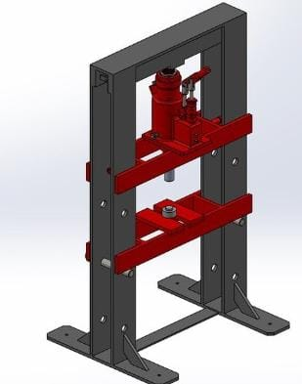
CAD Design of Compact Compression Molding Machine
Frame
Hydraulic Bottle Jack
Punch
Die
Base

Slide 9
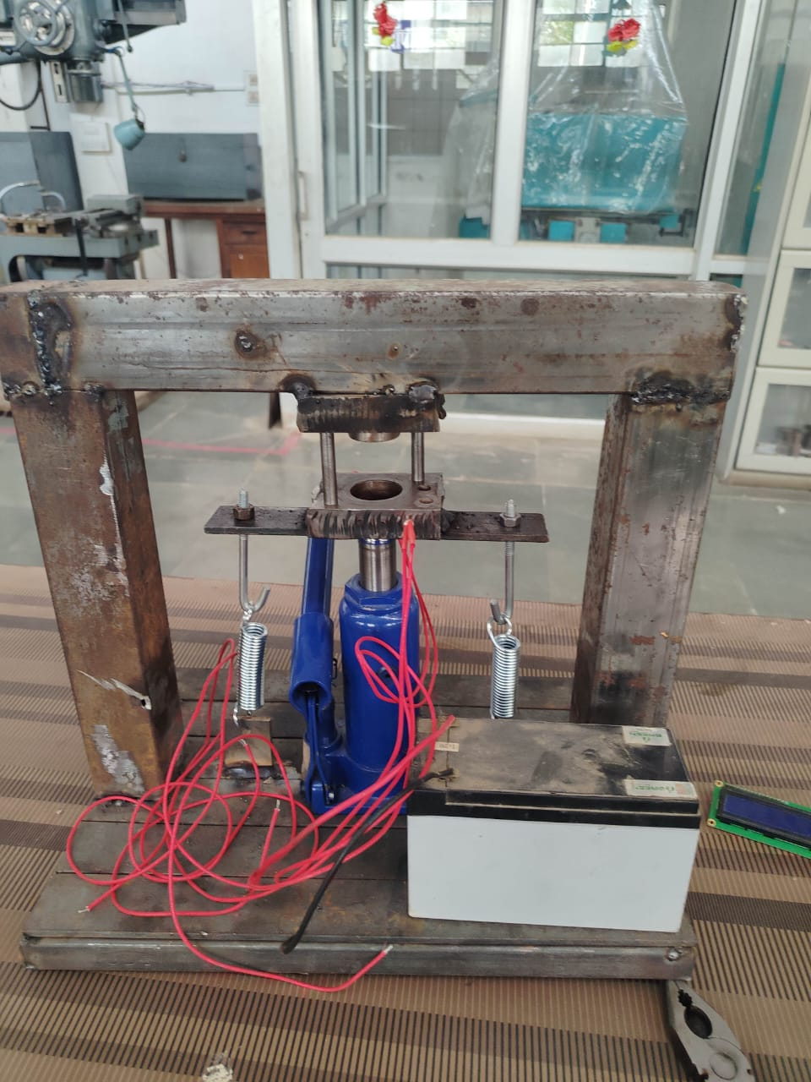
FABRICATED MACHINE SETUP: HYDRAULIC PRESS
Die
HYDRAULIC JACK(3TN)
PUNCH AND DIE
SPRINGS
FRAME
BASE PLATE
HEATER(X2)
BATTERY
Jack
Battery
Frame
Heater
Machine Set Up

Slide 10
PROCESS PARAMETERS
Melting Point: ~130 °C (for HDPE), ~160–170 °C (for PP)
Molding Temperature: ~180 °C (typical for both HDPE & PP )
Moulding Pressure(Mpa) : 3 -10 Mpa = 3 Mpa
Moulding Force (N) : PXA
Area of Cross Section = πxD^(2)/4 = 7.07cm^2
Force = Pressure X Area = 2.12 kN (<3)
Cooling Time (min) : thermoplastic parts require a cooling phase, lasting 1 to 3 minutes.

Slide 11

SAFETY MEASURES AND PRECAUTIONS
⚠️ Thermal Safety :
Handle heated molds and materials with thermal-resistant tools or gloves.
🔌 Operational Precautions :
Use a controlled release of pressure — do not suddenly unload the press.
🛠️ Machine and Equipment Safety :
Do not exceed the rated pressure of the jack or press being used.

Slide 12
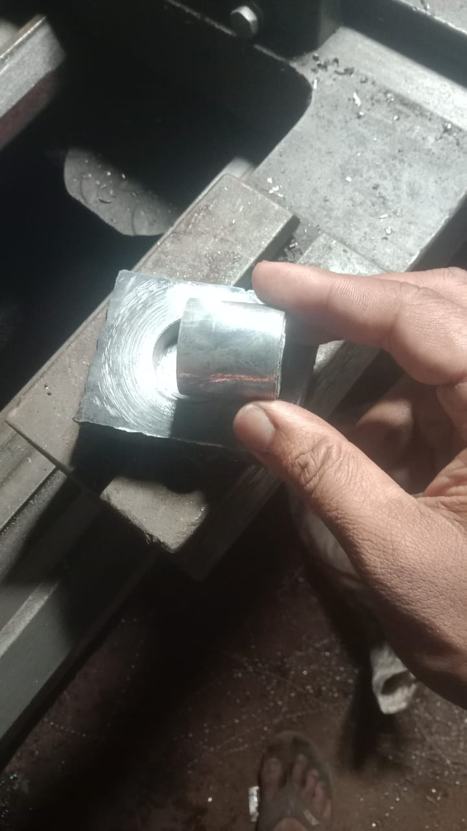
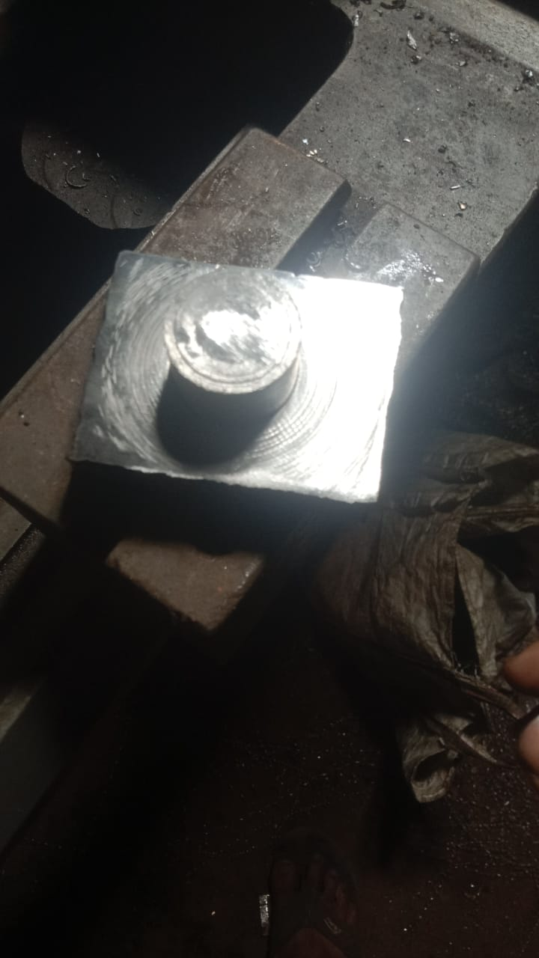
FABRICATION STEPS
Fabrication of Frame :
The frame was fabricated by using cs steel strips and rectangular cross section steel pipes .
Fabrication of Die and Punch :
Two rectangular HSS blocks were taken .One was bored for making die and the other was welded with cylindrical specimen for punch .
Punch
Die

Slide 13
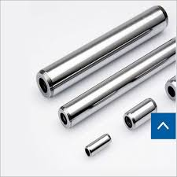
Correcting Inaccuracies in Die :
Inaccuracies like misalignment of surfaces , no clearance,
tilted axis of drilled holes were rectified .
Attaching Guide Pins:
Two pins were attached for alignment during compression
process .
Integrating the Machine:
The jack , frame , base and the die – punch were fitted together with the help of screws and fasteners and welded .

Slide 14
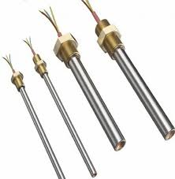
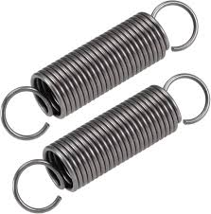
Adding springs for Automatic contraction:
Springs were attached with a hook to the base for automatic contraction of jack.
Integrating Heater:
A cartridge heater(X2) was integrated through blind holes in the die surface .

Slide 15
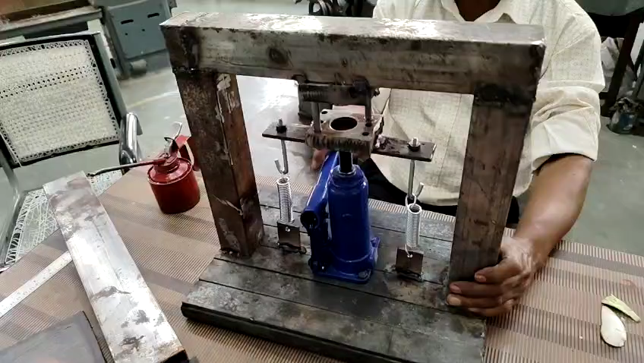
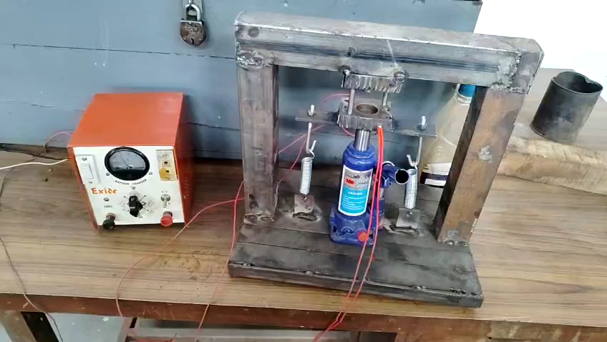
WORKING OF THE MACHINE

Slide 16
CHALLENGES AND TROUBLESHOOTING
The die and punch were not evenly faced .
Die and punch were not aligning with each other.
The jack needed an automatic system to decompress .
A suitable heater was required which would evenly heat the mould.
The mould required a temperature monitor and control for
safe temperature operation .
The mould required an ejection system for the hardened product .

Slide 17
REFERENCES
[1] Emanuele Pozza, PA12 Composites with Graphite and MWCNT Produced by SLS, Injection Moulding and Compression Moulding: Performance Analysis, Master’s Thesis, Università degli Studi di Padova, 2019/2020.

Slide 18
Thank You

